Slide 1


Alorica - PowerApps
Business Need
Alorica is an enterprise sized company that needed HR oriented tools to managed more than 10,000 users.
What We Did
Affirma created three enterprise levels tools using PowerApps to solve Alorica’s business need:
Annual Review and Goal Setting which supported the financial review and annual goals of over 1,000 users
Distribute and Measure Bonuses a tool created to manage and distribute bonuses based on a list of conditions supporting over 10,000 users
Distribute and Measure Annual Raises created to managed raises of over 10,000 users.
Affirma leveraged PowerApps, Azure SQL, SharePoint Online and Power BI to create Alorica’s HR tools.
Results
Tools successfully use PowerApps, Azure SQL, SharePoint and Power BI to create three HR tools for Alorica to manage the annual review, goal setting, bonuses and raises of over 10,000 users.

Slide 2
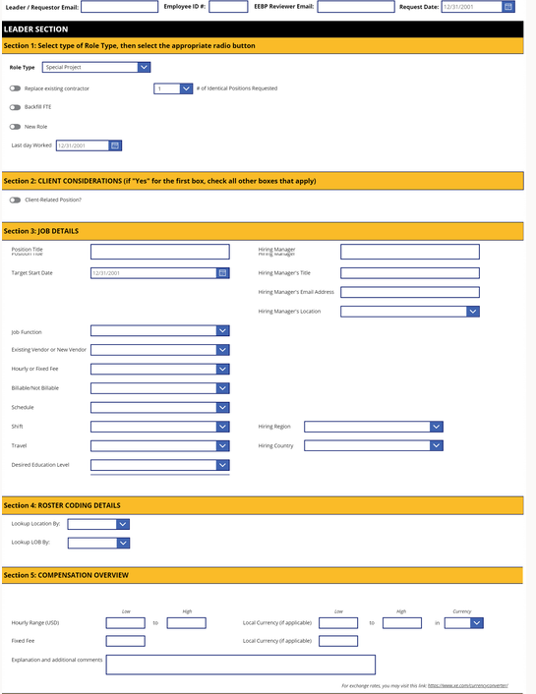
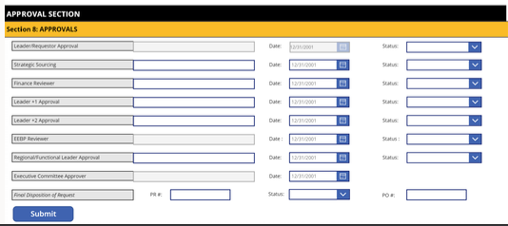
Alorica - Continued
Business Need
Alorica approached us with a request to create an intuitive yet powerful digital form, which would allow multiple managers across teams to craft new positions in the organization. Additionally, to ensure swift approvals from managers, Affirma was asked to create an automated process to allow managers to approve changes to the form.
What We Did Affirma produced a complete solution utilizing Microsoft PowerSuite, providing an engaging form coupled with an advanced automated approval flow; which drove internal process efficiency and management participation.
Created an “editing mode” link that allows users to interact with previously submitted versions of the form live.
Built the form with “dynamic interaction” in mind. Entire sections show/hide depending on selected options. The form adapts to the appropriate context.

